Slide 1

Amazon Web Services
workshop
for System Engineer
Using Amazon
Elastic Block Storage (EBS)

Slide 2
Topics
Understand of Amazon Elastic Block Storage (EBS)
Lab:
Create Amazon EC2
Attach EBS Volume to an instance
Snapshotting an EBS Volume

Slide 3
Objectives
You will be able to
Create EBS Volume.
Attach EBS Volume to an EC2 instance.
Snapshotting an EBS Volume.

Slide 4
What is Amazon EBS
Amazon Elastic Block Store (Amazon EBS) provides persistent block level storage volumes for use with Amazon EC2 instances in the AWS Cloud.
Each Amazon EBS volume is automatically replicated within its Availability Zone to protect you from component failure, offering high availability and durability.
Amazon EBS volumes offer the consistent and low-latency performance needed to run your workloads. With Amazon EBS, you can scale your usage up or down within minutes – all while paying a low price for only what you provision.
Amazon EBS allows you to create storage volumes and attach them to Amazon EC2 instances. Once attached, you can create a file system on top of these volumes, run a database, or use them in any other way you would use a block device.

Slide 5
Amazon EBS Volume Types
All EBS volume types offer the same durable snapshot capabilities and are designed for 99.999% availability.
Amazon EBS provides three volume types. Each type differ in performance characteristics and cost, so you can choose the right storage performance and price for the needs of your applications.
General Purpose (SSD)
Provisioned IOPS (SSD)
Magnetic

Slide 6
Amazon EBS : General Purpose (SSD) Volumes
General Purpose (SSD) volumes are the default EBS volume type for Amazon EC2 instances.
General Purpose (SSD) volumes are backed by Solid-State Drives (SSDs) and are suitable for a broad range of workloads, including small to medium-sized databases, development and test environments, and boot volumes.
General Purpose (SSD) volumes provide the ability to burst to 3,000 IOPS per volume, independent of volume size, to meet the performance needs of most applications.
General Purpose (SSD) volumes also deliver a consistent baseline of 3 IOPS/GB and provide up to 128MBps of throughput per volume. I/O is included in the price of General Purpose (SSD) volumes, so you pay only for each GB of storage you provision.
If you need a greater number of IOPS than General Purpose (SSD) volumes provide or you have a workload where performance consistency is critical, we recommend that you use Amazon EBS Provisioned IOPS (SSD) volumes.

Slide 7
Amazon EBS : Provisioned IOPS (SSD) Volumes
Provisioned IOPS (SSD) volumes offer storage with consistent and low-latency performance, and are designed for applications with I/O-intensive workloads such as databases. Backed by Solid-State Drives (SSDs).
Provisioned IOPS volumes support up to 30 IOPS per GB, which enables you to provision 4,000 IOPS on a volume as small as 134 GB. You can also achieve up to 128MBps of throughput per volume with as little as 500 provisioned IOPS. Additionally, you can stripe multiple volumes together to achieve up to 48,000 IOPS or 800MBps when attached to larger EC2 instances.
To maximize the benefit of Provisioned IOPS (SSD) volumes, we recommend using EBS-optimized EC2 instances. When attached to EBS-optimized instances, Provisioned IOPS (SSD) volumes can achieve single-digit millisecond latencies and are designed to deliver the provisioned performance 99.9% of the time. For more information about instance types that can be launched as EBS-optimized instances, see Amazon EC2 Instance Types.

Slide 8
Amazon EBS : Magnetic Volumes
Magnetic volumes provide the lowest cost per GB of all EBS volume types.
Magnetic volumes are backed by magnetic drives and are ideal for workloads where data is accessed infrequently, and scenarios where the lowest storage cost is important. Magnetic volumes provide approximately 100 IOPS on average, with an ability to burst to hundreds of IOPS.
If you need a greater number of IOPS or higher performance than what a Magnetic volume will provide, we recommend that you consider Amazon EBS General Purpose (SSD) or Provisioned IOPS (SSD) volumes.

Slide 9
AWS EBS Volume Types & Pricing
Volumn Type |  | EBS General Purpose (SSD) | EBS Provisioned IOPS (SSD) | EBS Magnetic
Use Cases |  | Boot volumes Small to Med DBs Dev and Test | I/O intensive Relational DBs NoSQL DBs | Infrequent Data Access
Storage Media |  | SSD-backed | SSD-backed | Magnetic disk-backed
Max Volume Size |  | 1TB | 1TB | 1TB
Max IOPS/volume |  | 3,000 (burst) | 4,000 | 40 - 200
Max throughput/volume |  | 128MBps | 128MBps | 40 - 90MBps
Max IOPS/instance |  | 48,000 | 48,000 | 48,000
Max throughput/instance |  | 800MBps | 800MBps | 800MBps
API Name |  | gp2 | io1 | standard
Price* |  | $0.12 per GB-month of provisioned storage | $0.138 per GB-month of provisioned storage $0.072 per provisioned IOPS-month | $0.08 per GB-month of provisioned storage $0.08 per 1 million I/O requests
*Prices shown in Asia Pacific (Singapore)
$0.095 per GB-month of data stored snapshots to Amazon S3

Slide 10
Amazon EBS Snapshots
Amazon EBS provides the ability to save point-in-time snapshots of your volumes to Amazon S3.
Amazon EBS Snapshots are stored incrementally: only the blocks that have changed after your last snapshot are saved, and you are billed only for the changed blocks.
If you have a device with 100 GB of data but only 5 GB has changed after your last snapshot, a subsequent snapshot consumes only 5 additional GB and you are billed only for the additional 5 GB of snapshot storage

Slide 11
Lab: Introduction to Amazon EBS
Overview
This guide introduces you to Amazon Elastic Block Storage (EBS) using the AWS Management Console.
4 labs.
Topic Covered
Create Linux Ubuntu 14.04 LTS Server on EC2
Creating an EBS Volume in the Amazon Management Console.
Adding an EBS Volume to an instance.
Snapshotting an EBS Volume.
Note:
Do not delete EC2 and EBS after finish this lab. It will be use in next chapters.

Slide 12
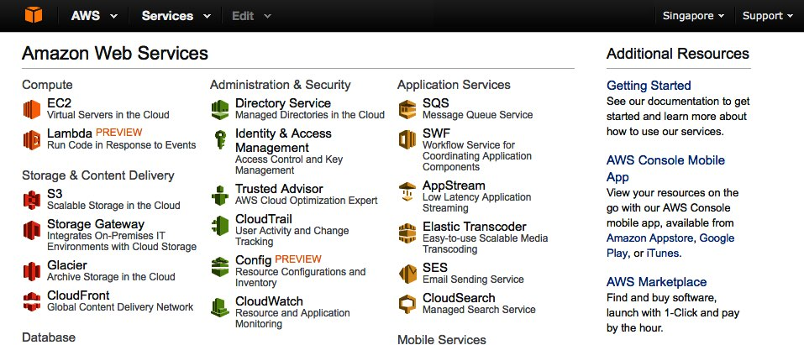
Lab 1-4: Login to AWS Console
Goto https://console.aws.amazon.com, enter AWS username and password and then click Login button.
In AWS Console, change Region to Singapore.
Click EC2 link under “Compute” group to open EC2 service console.

Slide 13
Lab 1-4: Create EC2 Instance
In EC2 Management page, click Launch Instance button.
Step 1. click Select button for Ubuntu Server 14.04 LTS (HVM), SSD Volume Type - ami-d6e7c084 (64 bit)
Step 2. Leave the instance type set to default, which is t2.micro. Click Next: Configure Instance Details Button.
Step 3. Leave the default options and click Next: Add Storage.
Step 4: Add Storage. Leave the default options and click Next: Tag Instance button.
Step 5: Tag Instance.
Provide a name for your instance in the Value field of the Name attribute. Uses <your_name>_db as instance name.
Click Create Tag button. Enter “Group” in the new Key field, and provide <your_name>_group for Value field.

Slide 14
Lab 1-4: Create EC2 Instance
Step 6: Security Group.
Choose Create a new security group for Assign a security group. AWS will create SSH rule for you.
Enter <your_name>_mongo_sg for Security Group Name and leave Description as default.
Click Add Rule button, the new rule type should be Custom TCP Rule, enter Port Range to 27017, change Source to Anywhere.
Click Review and Launch button.
Step 7: Click Launch button. A Key Pair Dialog appears.
In the Select key pair dialog (after click Launch button), choose an exist key pair and choose your created key from previous chapter.
Click check box I acknowledge…, then click Lunch Instances button.
Click Launch Instances button.

Slide 15
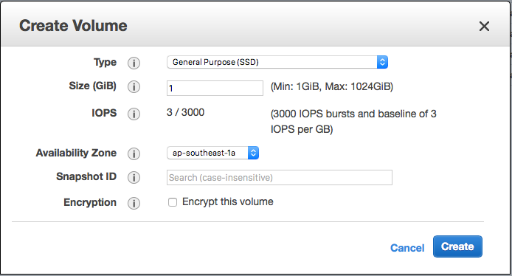
Lab 2-4: Create EBS
In EC2 Management page, click menu Volumes under Elastic Block Storage in the left navigation pane.
Create a new volume by clicking Create Volume button. In the Create Volume window, select the following:
Volume Type: General Purpose (SSD)
Size: 10
Click Create button. Wait until the volume state change to available.
Name your volume <your_name>_db by move mouse over your volume’s name column, the pencil icon should appear, click the pencil icon and named it.

Slide 16
Lab 2-4: Adding an EBS Volume to an instance
From Volume screen, right click on the EBS volume you just created and choose Attach Volume.
Click in the Instance field and a list of running instances will pop up. Choose your instance then click Attach button. The EBS volume state should changes to in-use. Note: The new partition will attach to /dev/xvdf.

Slide 17
Lab 3-4: Use EBS Volume inside EC2 Instance
SSH to your EC2 instance.
Install xfsprogs
Create XFS partiton and mount to /mnt
> sudo apt-get install xfsprogs
> sudo mkfs.xfs /dev/xvdf
> sudo mount /dev/xvdf /mnt
> sudo sed -i '$ a /dev/xvdf /mnt xfs noatime 0 0' /etc/fstab

Slide 18
Lab 3-4: Install MongoDB
Install MongoDB
Change MongoDB configuration :-
Change the value of dbpath=/var/lib/mongodb to /mnt/data
Delete “#” character from #port=27017
Add comment character (#) at the left most of the line “bind_ip = 127.0.0.1”
Press Control+O on keyboard to save the configuration, press Enter to confirm file to write. Then press Control+X to exit from nano.
> sudo apt-key adv --keyserver hkp://keyserver.ubuntu.com:80 --recv 7F0CEB10
> echo 'deb http://downloads-distro.mongodb.org/repo/ubuntu-upstart dist 10gen' | sudo tee /etc/apt/sources.list.d/mongodb.list
> sudo apt-get update
> sudo apt-get install -y mongodb-org
> sudo nano /etc/mongod.conf
port = 27017
#bind_ip = 127.0.0.1

Slide 19
Lab 3-4: Install MongoDB
Prepare data folder for MongoDB in /mnt partition.
Test MongoDB
Close the SSH session.
> sudo mkdir -p /mnt/data
> sudo chmod a+w -R /mnt
> sudo stop mongod
> sudo start mongod
> mondo
in Mongo shell...
>> show dbs
>> exit

Slide 20
Lab 4-4: Snapshotting an EBS Volume
In the EC2 Management Console, choose your instance, right-click and then choose menu Instance State -> Stop, click Yes, Stop button.
Click menu Volumes under Elastic Block Storage in the left navigation pane. Right-click your EBS volume, click Detach Volume, and click Yes, Detach button.
Right-click the volume again, and choose Create Snapshot.
Name: input <your_name>_db_snapshot
Click Create button, click Close.
Now, we will increase the volume size and enable provisioned IOPS for increase performance. Open Snapshot list by click menu Snapshots in the left navigation pane.
Right-click your EBS volume, then click Create Volume.
Change size to 20.
Click Create button. Click Close.

Slide 21
Lab 4-4: Snapshotting an EBS Volume
go back to the volume page by click menu Volumes under Elastic Block Storage in the left navigation pane.
Follows step 4-6 in Lab 2-4, start your EC2 instances and SSH to it to check the MongoDB. It should started as usual.
Expand the partition to full disk size.
> df -h // to check /mnt partition size.
> sudo xfs_growfs /dev/xvdf // to expand partition to largest possible size.
> df -h // to check /mnt partition size again. // you can see the partition size increased.

Slide 22
Conclusion
Congratulation! You’re finished this lab. In this lab, you:
Create a new Elastic Block Storage to keep MongoDB data AWS Management Console.
Install MongoDB and configure the storage location.
Create Elastic Block Storage snapshot using AWS Management Console.

Slide 23
References
Amazon EBS http://aws.amazon.com/ebs/
Amazon EBS Details http://aws.amazon.com/ebs/details/
Amazon EBS Pricing http://aws.amazon.com/ebs/pricing/
How to Resize XFS partition on Ubuntu Linux http://ask.xmodulo.com/expand-xfs-file-system.html

